Slide 1
VEDIC MATHS
SHORTCUTS TO BE COVERED:
1.MULTIPLICATION
2. DIVISION
3. SQUARE ROOT
4. CUBE ROOT
5. SQUARE OF A NUMBER
6. CUBE OF A NUMBER

Slide 2
MULTIPICATION & DIVISION
MULTIPY B5 5, 25,125
DIVISION BY 5,25,125
for 5, multiply number by 10 and divide by 2
for 25, multiply number by 100 and divide by 4
for 125, multiply number by 1000 and divide by 8.
for 5, multiply number by 2 and divide by 10.
for 25, multiply number by 4 and divide by 100.
for 125, multiply number by 8 and divide by 1000.

Slide 3
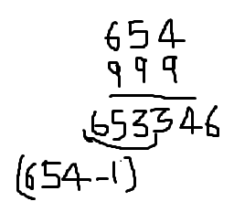
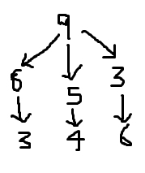
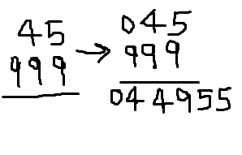
MULTIPLICATION OF NUMBER WITH SERIES OF 9’S
step1: we subtract 1 from given number to obtain first half of answer.
step 2: subtract each number(obtain from first step) from 9 to get second half.
ANOTHER EXAMPLE:

Slide 4
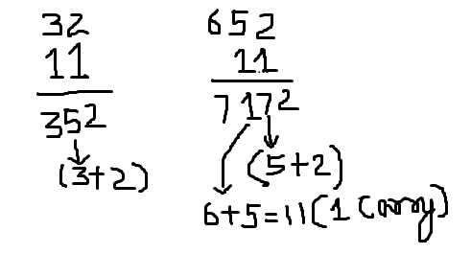
MULTIPLICATION OF NUMBER WITH SERIES OF 1’S
step 1: write the right hand most digit as it is.
step 2: we add 2 to the number in left 3 and writ 5.
write left hand most digit as it is.
note: number multiply by 11, 111,1111 accordingly number added in pair, triplets etc.

Slide 5
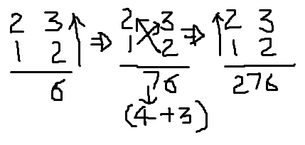
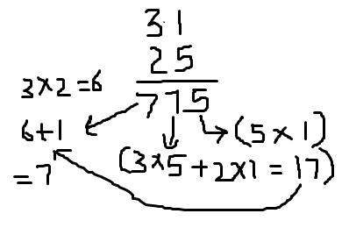
MULTIPLICATION OF NUMBER USING CRISS CROSS
suppose we need to multiply 23 and 12
suppose we need to multiply 31 and 25

Slide 6
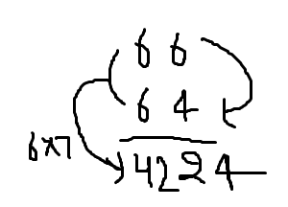
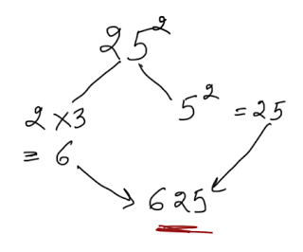
SQUARE NUMBERS ENDING WITH 5
step 1: last digits will be 5*5
step 2: after 2, 3 comes , multiply 2*3=6
note: in below case last digit sum is 10 and remaining is same.
last digits of number is different but there sum is 10, same method can be used.
note: first digit should be same in this case.

Slide 7
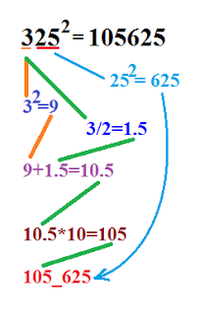
SQUARE NUMBERS ENDING IN 25:
step 1. 325 = 3_25 => 3
step 2. square the number from step 1: 3² = 9
step 3. divide the number from step 1 by 2: 3/2 =1.5
step 4. add step 2 and step 3 : 9 + 1.5 = 10.5
step 5. multiply the number from step 4 by 10: 10.5 * 10 =105
step 6. write the number 625 next to the result from step 5: 105_625 = 105625

Slide 8
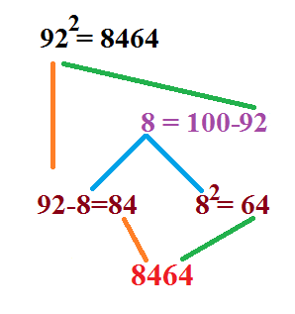
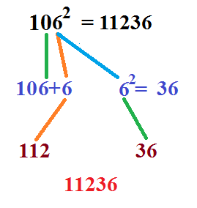
SQUARE NUMBERS BETWEEN 80 AND 130 base value 100, if more than added and if less than subtracted to obtain result
# Below 100
# Above 100

Slide 9
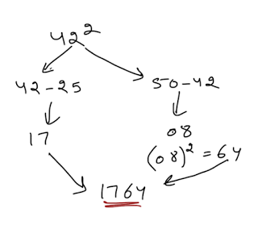
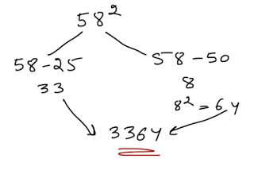
SQUARE NUMBERS BETWEEN 30 AND 80 BASE VALUE 50, FOR FIRST NO’S 25 WILL BE CONSIDERED.
# Below 50
# Above 50

Slide 10
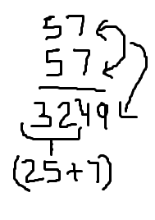
SQUARE OF A NUMBER BETWEEN 50 TO 60.
step 1: add 25 to digit in unit place and put it on left side.
step 2: square the digits on unit place and put in right side.

Slide 11
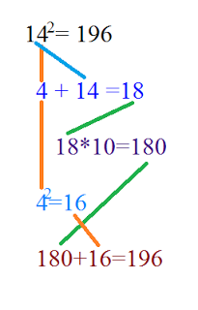
SQUARE NUMBERS BETWEEN 10 AND 19, BASE VALUE WILL BE 10, ADD THE DIFFERNECE WITH THE NUMBER TO OBTAIN RESULT.

Slide 12
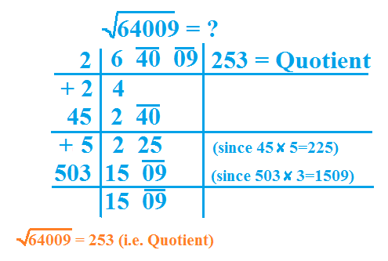
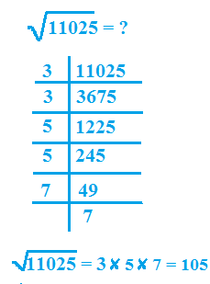
SQUARE ROOT SHORTCUTS
#Division
# Prime Factor

Slide 13
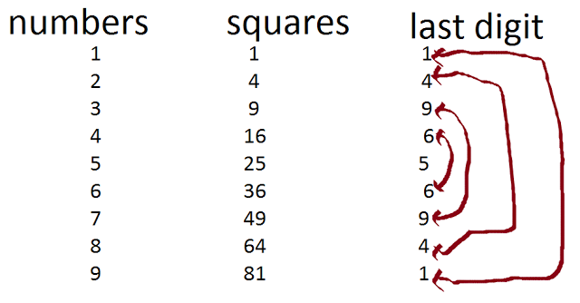
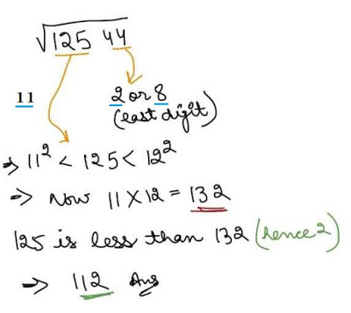
SQUARE ROOT SHORTCUTS step1: check unit digit of the no(in pair). step2: select whose square less than remaining no step3: multiply no with next no. step4: compare & select

Slide 14
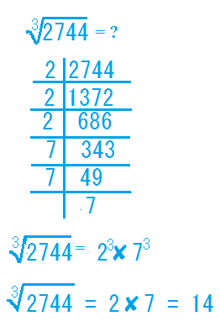
CUBE ROOT
# Prime Factor Method

Slide 15
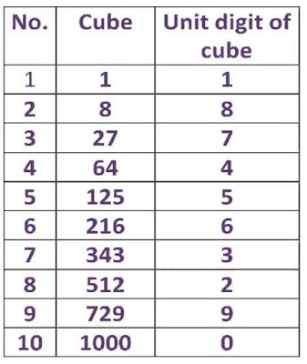
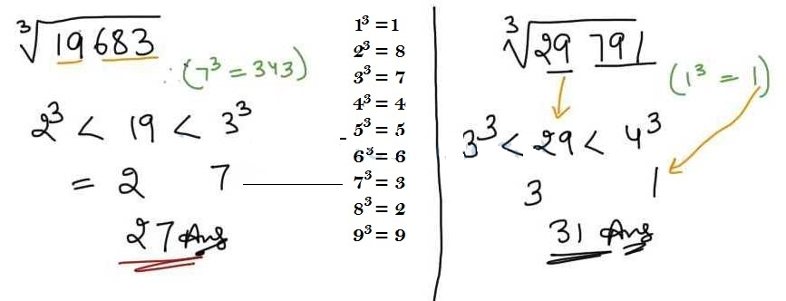
CUBE ROOT SHORTCUTS

Slide 16
QUESTIONS(?)
1.Find the product of number:
(1)45*45 (2)95*95
A. 3035 A. 9125
B. 2025 B. 9115
C. 1025 C. 9025
D. 1005 D.9225
Notes:
SOL.B
SOL. C

Slide 17
2.Find the product of : (1)111*119 (2) 107*103 A.13209 A.11121 B. 13109 B. 11021 C. 14009 C. 11131 D.13219 D. 10021
Notes:
SOL.A
SOL.B

Slide 18
6. Find the square root of the following numbers?
16641 (2)33489
119 A. 173
129 B. 163
139 C.183
149 D.153
Notes:
6(1). SOL. B
Unit digit will be 1 or 9.
Since, 12² < 166 < 13²
So, the square root will definitely be 121 or 129.
Now, consider 12 and 13
Since, 166 is greater the 156, we pick the larger of the options i.e. 129.
6(2). SOL. C
Unit digit will be 3 or 7.
Since, 18² < 334 < 19²
So, square root will be 183 or 187.
Now consider 18 and 19.
Now, 334 is less than 342. So, the square root will be lesser of the two numbers i.e. 183.

Slide 19
7. Find the cube root of the following numbers?
970299 = ? (2) 140608 = ?
89 A. 42
99 B.62
79 C.52
69 D.72
Notes:
7(1). SOL. B
Unit digit of number is 9
∴ Unit digit of cube root will be 9
Now we will consider 970
Since, 9³ < 970 < 10³
So, we find cube root of the number to be 99.
7(2). SOL. C
Unit digit of number is 8
∴ Unit digit of cube root will be 2
Now we will consider 140
Since, 5³ < 140 < 6³
So, we find cube root of the number to be 52.

Slide 20


